Slide 1
Natural Language Processing
Unit 1
Faizan Javed
DataScience @ SMU

Slide 2
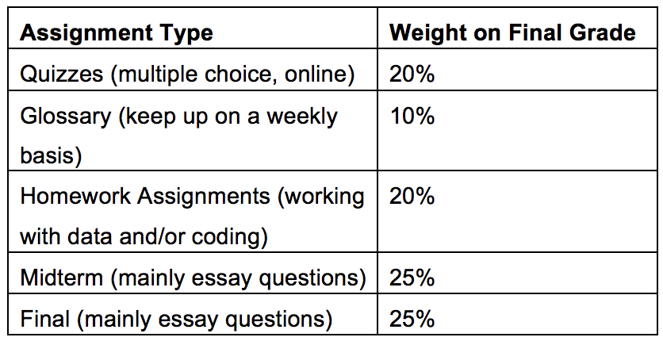
Instructor: Faizan Javed (fjaved@smu.edu)

Slide 3
What is Natural Language Processing?
A subfield of linguistics, computer science, information engineering, and artificial intelligence concerned with the interactions between computers and human (natural) languages, in particular how to program computers to process and analyze large amounts of natural language data. **Wikipedia
Natural language processing (NLP) is a branch of artificial intelligence that helps computers understand, interpret and manipulate human language. **SAS

Slide 4
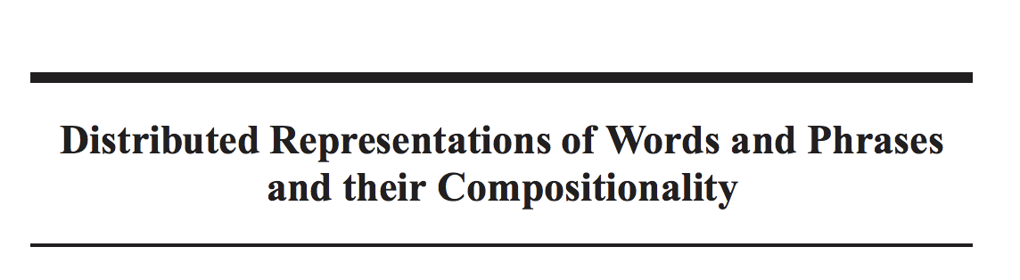
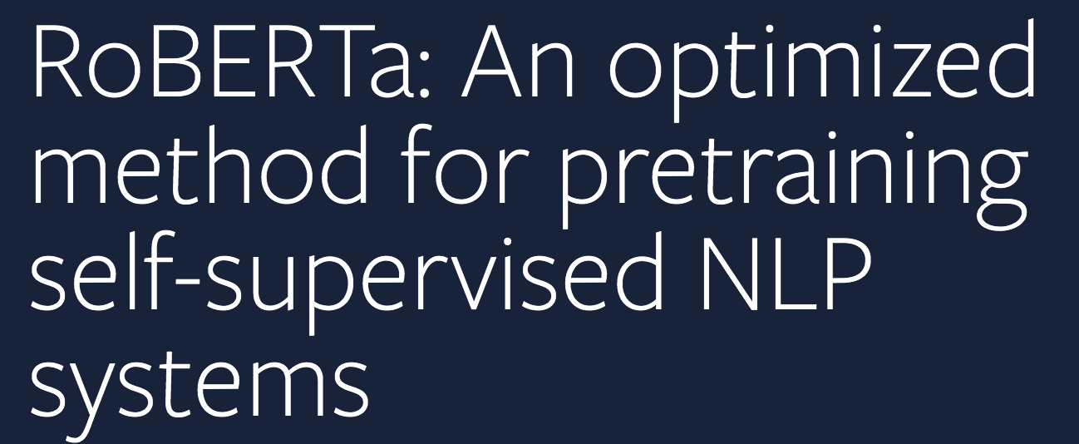
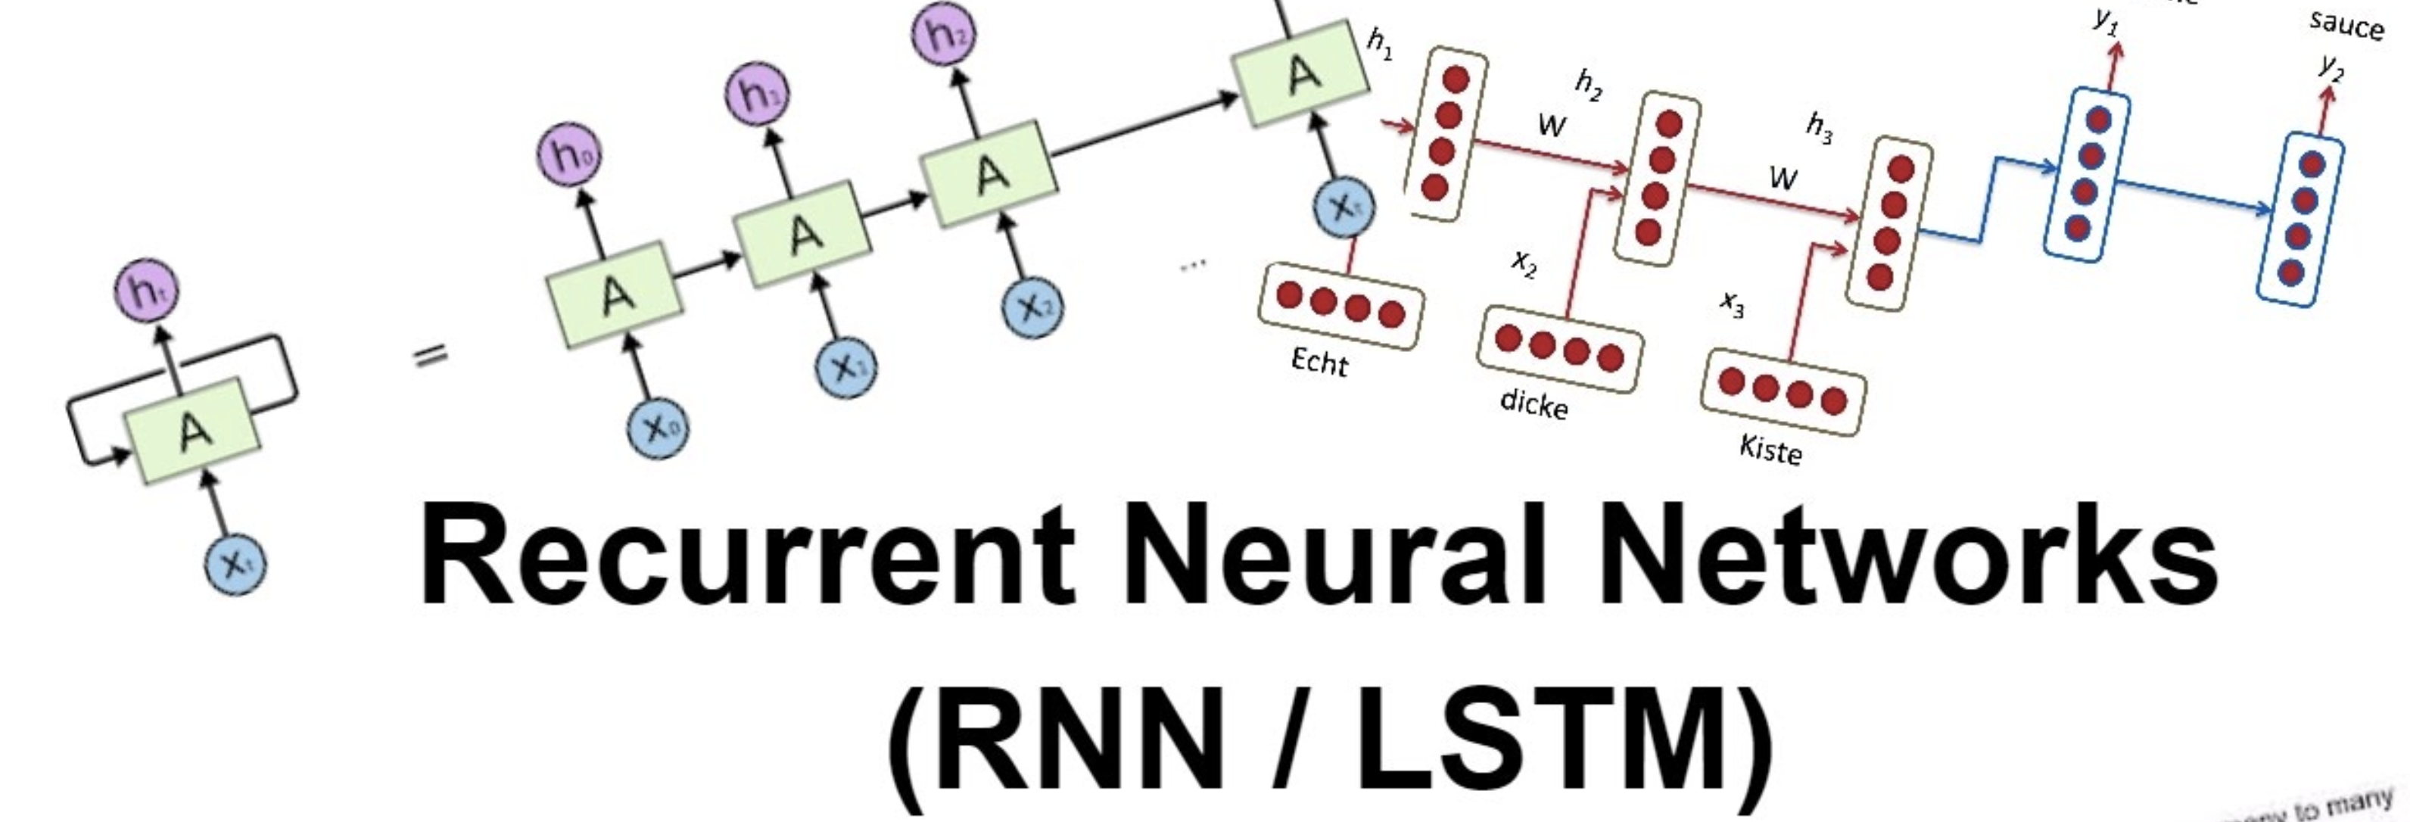
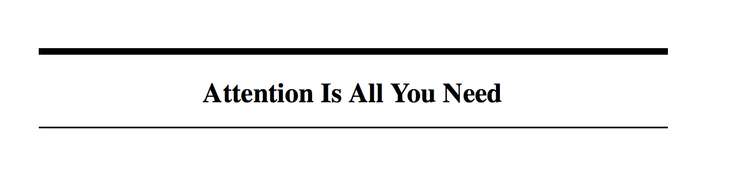
Explosive growth in NLP over the past few years!
Top developments thread: https://twitter.com/wzuidema/status/1212727352037429248
NLP year in review: https://medium.com/dair-ai/nlp-year-in-review-2019-fb8d523bcb19
ACL 2019: Top research trends: https://www.topbots.com/top-nlp-research-trends-acl-2019/
Top deep learning NLP trends: https://blog.floydhub.com/ten-trends-in-deep-learning-nlp/
Four biggest problems in NLP: https://ruder.io/4-biggest-open-problems-in-nlp/
The fall of RNN/LSTM; https://towardsdatascience.com/the-fall-of-rnn-lstm-2d1594c74ce0

Slide 5
Natural vs Artificial Languages
English, Spanish, French vs Python, R, Scala (Pig Latin?)
Large vocabulary Complex syntax Ambiguous semantics Even more problems such as humor, irony, metaphor, connotation, neologisms | Concise Readily parsed Unambiguous Subject to regular, consistent rules of interpretation

Slide 6
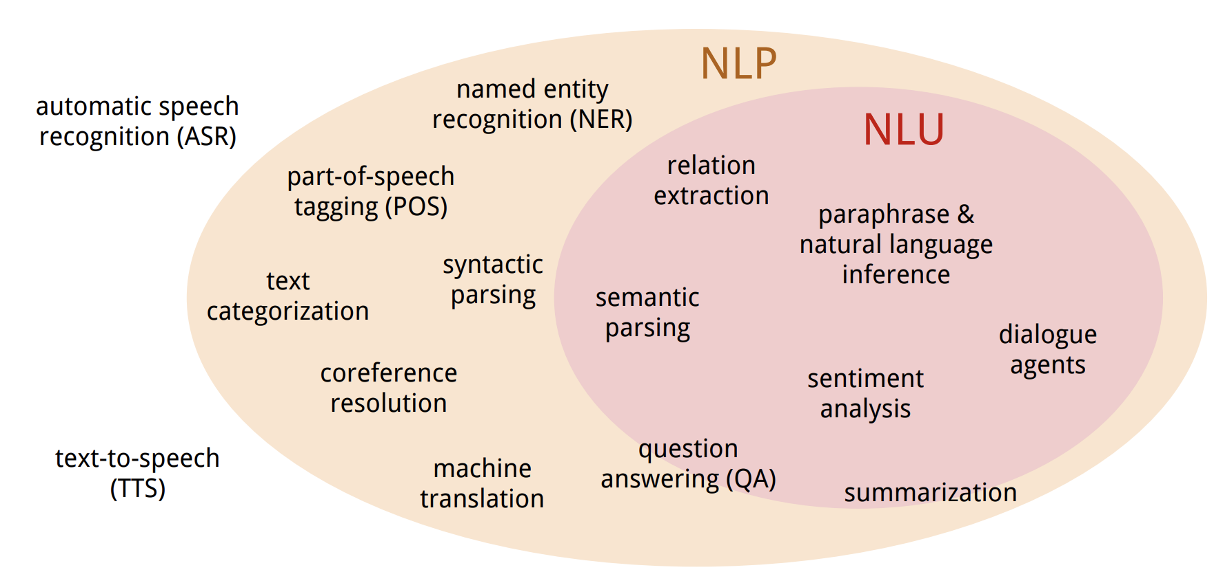
Two sides of NLP : NLU and NLG
Natural Language Understanding: produce a useful representation (usually a structured representation) of some inputted natural language.
Natural Language Generation: transform structured data into natural language (“put concept into words”)

Slide 7
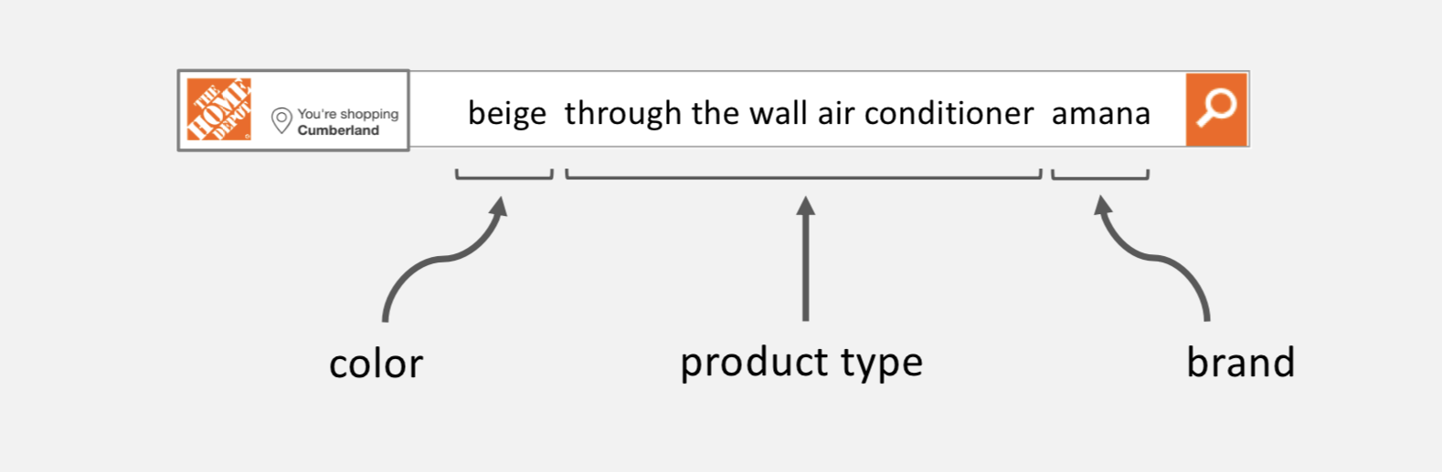
NLU applications – Named Entity Recognition (NER)
Locating entities in unstructured text

Slide 8
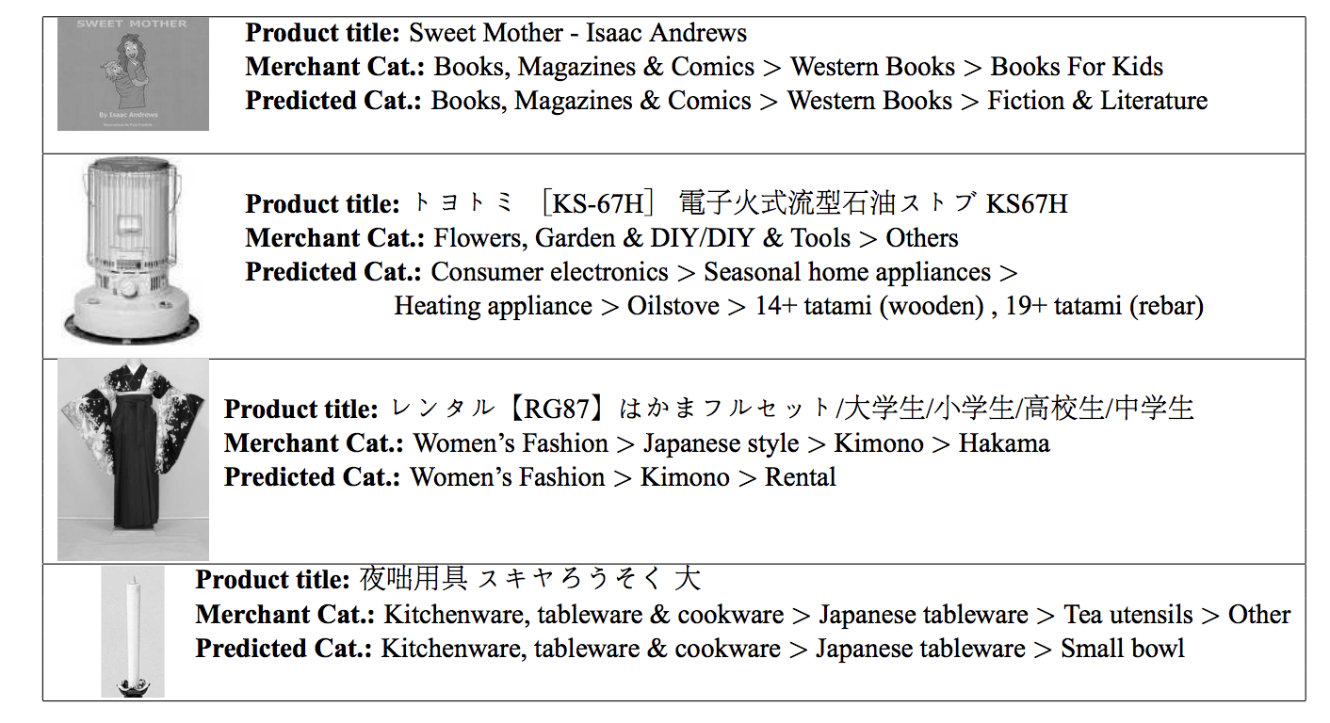
NLU applications – Document Classification
Categorize documents into one (or more) classes or topics

Slide 9
NLU applications – Sentiment Analysis
Understanding sentiment (views/opinions/emotions) from text
This tour is great! Positive
I do not dislike this tour Neutral
This is a perfect example of what a tour should not be Negative

Slide 10
NLU applications – Search: Query Understanding
Inferring the intent and meaning of a search engine users queries.
Query Segmentation: partition the queries into semantic units
“Dallas home depot stores” : Dallas, home, depot, stores vs Dallas, home depot, stores
Query Scoping (NER): map query segments to entity types
Query Expansion: broaden the query by adding additional phrases/tokens (typically synonyms and abbreviations).
“ML Developer” : (ML OR “Machine Learning”) AND (Developer or Engineer)
Query Relaxation: make the query less restrictive by removing tokens.
“Black propane grill” : Black propane vs Propane Grill (propane is more specific than black)
DSC ATL 2019 presentation: Query Rewrite for Search, 2019
https://www.youtube.com/watch?v=lJWlHnRFUtY&list=FLuf0igTyKhlXFuzk7S2czLg

Slide 11
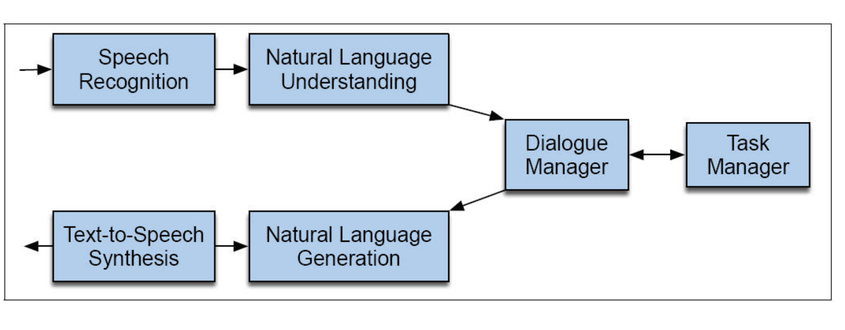
NLU/NLG applications – Dialog Systems (conversational agents, chatbots)
A system that communicates with humans using natural language.
Hey Alexa, what’s the weather like today?
It’s forecasted to be raining today in Atlanta, you might want to bring an umbrella.

Slide 12
NLU/NLG applications – Machine Translation (MT)
Translate source text in one language to another.
Google AI Blog:
https://ai.googleblog.com/2016/09/a-neural-network-for-machine.html

Slide 13
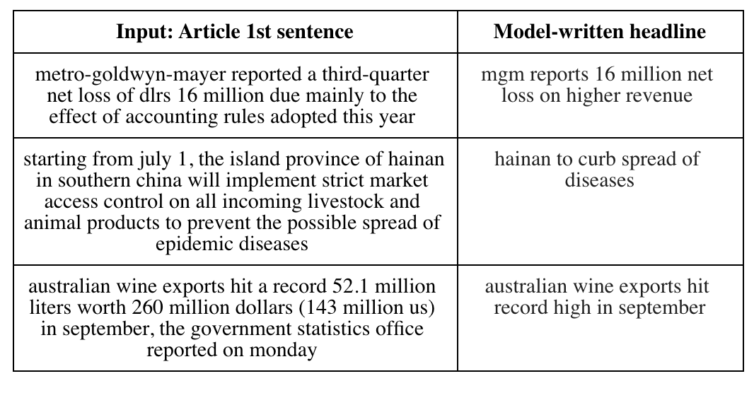
NLG applications – Document Summarization
Generate accurate summaries of longer text.

Slide 14
Lexical Diversity
“the range of different words used in a text, with a greater range indicating a higher diversity” (McCarthy and Jarvis 2010: 381).
Ratio of unique words to total number of words: a measure of text complexity
{“boss”, “ponders”} vs {”boss”, “leader”, “thinks”, “ponders”}
Measures: Text-Type Ratio (TTR), vocd, and the measure of textual lexical diversity (MTLD

Slide 15
Collocation & Word sense disambiguation
Frequently co-occurring words (bigrams, trigrams)
“machine learning”, “social media”, “non smoking room”, “flat screen tv”
Are all collocated words meaningful? E.g., “of the”
WSD: identifying the sense of a polysemic word.
“The bank will be closed this Saturday. ”
“The river overflowed the bank.”

Slide 16
What did you learn today?
Questions?

